Slide 1


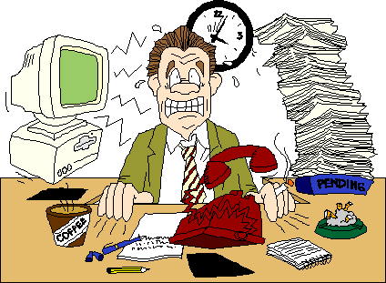

Slide 2


Right from the time of birth till the last breath drawn, an individual is invariably exposed to various stressful situations. The modern world which is said to be a world of achievement is also a world of stress and has been called the –
Age of Anxiety and Stress.

Slide 3
The word stress was originally used by Selyle in 1956 to describe the pressure experienced by a person in response to life demands. These demands are referred to as stressors. Stress can be positive or negative.

Slide 4



According to Selyle (1956), ―Stress is defined as the pressure experienced by a person in response to life demands. These demands are referred to as stressors and include a range of life events, physical factors (e.g.: cold, hunger, haemorrhage, pain), environmental conditions and personal thoughts.

Slide 5
According to Selye (1976)
Stress is a process of adjusting to or dealing with circumstances that disrupt or threaten to disrupt a person’s physical or psychological functioning.
Stress is tension, strain, or pressure from a situation that requires us to use, adapt, or develop new coping skills.

Slide 6


Stressor is the stimuli proceeding or precipitating a change. It may be internal (fear, guilt) or external (trauma, peer pressure, etc).

Slide 7





Stress due to an excess of adaptive demands placed upon us. The demands are so great that they lead to bodily and mental damage.
e.g.: unexpected death of a loved one.

Slide 8




The optimal amount of stress, which helps to promote health and growth. e.g.: praise from a superior for hard working.

Slide 9

Physiological stressors:
Chemical agents
Physical agents
Illness, injuries, hormonal fluctuations, inadequate sleep or nutrition
Infectious agent
Nutrition imbalances
Genetic or immune disorders

Slide 10


Accidents can cause stress for the victim, the person who caused the accident and the families of both
Stressful experiences of family members and friends
Fear of aggression or mutilation from others such as murder, rape, terrorist and attacks.

Slide 11
Events that we see on T.V. such as war, earthquake, violence
Developmental and life events
Rapid changes in our world, including economic and political structures and technology

Slide 12

There are many sources of stress, these are broadly classified as:
Internal stressors: they originate within a person e.g.: cancer, feeling of depression.
External stressors: it originates outside the individual e.g.: moving to another city, death in a family.

Slide 13
Developmental stressors: it occurs at predictable times throughout an individual‘s life. e.g.: child- beginning of school.
Situational stressors: they are unpredictable and occur at any time during life. It may be positive or negative. e.g.: death of family member, marriage/ divorce.

Slide 14

It may be physiological, psychological and cognitive:
Physiological indicators:
The physiological signs and symptoms of stress result from activation of sympathetic and neuro- endocrine systems of body.

Slide 15
Pupils dilate to increase visual perception
Sweat production increases
Heart rate and cardiac output increases Skin is pallid due to peripheral blood vessel constriction
Mouth may be dry Urine output decreases

Slide 16
Psychological Indicators:
The manifestations: of stress includes anxiety, fear, anger, depression and unconscious ego defense mechanism.
Anxiety: state of mental uneasiness, apprehension, dread or feeling of helpless. It can be experienced at conscious, subconscious or unconscious level

Slide 17
Fear: It is an emotion/ feeling of apprehension aroused by impending or seeming danger, pain or threat.
Depression: It is an extreme feeling of sadness, despair, lack of worth or emptiness.
Unconscious ego defense mechanism: It is a psychological adaptive mechanism developing as the personality attempts to defend itself and allay inner tensions.

Slide 18
Cognitive Indicators:
Problem solving: the person assesses the situation or problem analyzes, chose alternatives, carries out selected alternatives and evaluates.
Structuring: arrangement/ manipulation of a situation so that threatening events do not occur.

Slide 19
Self-control: assuming a manner and facial expression that conveys a sense of being in control or in change.
Suppression: willfully putting a thought or feeling out of mind.
Day dreaming: unfulfilled wishes and desires are imagined as fulfilled or a threatening experience is re worked or re played so that it ends differently from reality.

Slide 20

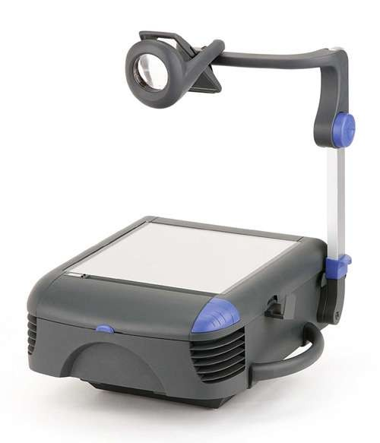

Slide 21


Stress management involves controlling and reducing the tension that occurs in stressful situations by making emotional and physical changes. The degree of stress and the desire to make the changes will determine how much change takes place.

Slide 22

Adopting a humorous view towards life`s situations can take the edge off everyday stressors. Not being too serious or in a constant alert mode helps maintain the equanimity of mind and promote clear thinking. Being able to laugh stress away is the smartest way to ward off its effects.

Slide 23
Benefits of laughter:
Laughter lowers blood pressure and reduces hypertension.
It provides good cardiac conditioning especially for those who are unable to perform physical exercise.
Reduces stress hormones (studies shows, laughter induces reduction of at least four of neuroendocrine hormones—epinep hrine, cortisol, dopamine and growth hormone, associated with stress response).

Slide 24
Boosts immune function by raising levels of infection-fighting T-cells, disease-fighting proteins called Gamma-interferon and disease- destroying antibodies called B-cells.
Laughter triggers the release of endorphins—body`s natural painkillers.
Produces a general sense of well- being.

Slide 25
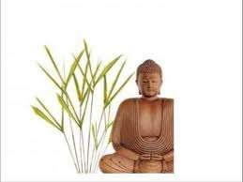
AUTOGENIC TRAINING:

Slide 26
It is a relaxation technique developed by the German psychiatrist Johannes Heinrich Schultz and first published in 1932. The technique involves the daily practice of sessions that last around 15 minutes, usually in the morning, at lunch time, and in the evening.

Slide 27
During each session, the practitioner will repeat a set of visualizations that induce a state of relaxation. Each session can be practiced in a position chosen amongst a set of recommended postures (for e.g.: lying down, sitting meditation). The technique can be used to alleviate many stress-induced psychosomatic disorders.

Slide 28
E.g. of an autogenic training session are:
Sit in the meditative posture and scan the body
"my right arm is heavy"
"my arms and legs are heavy and warm" (repeat 3 or more times)
"my heartbeat is calm and regular" (repeat 3 times)
"my forehead is cool"
"my neck and shoulders are heavy" (repeat 3 times)
"I am at peace" (repeat 3 times)

Slide 29

Autogenic Training restores the balance between the activity of the sympathetic (flight or fight) and the parasympathetic (rest and digest) branches of the autonomic nervous system. This has important health benefits, as the parasympathetic activity promotes digestion and bowel movements, lowers the blood pressure, slows the heart rate, and promotes the functions of the immune system.

Slide 30

Hobby is an activity or interest that is undertaken for pleasure or relaxation, typically done during one's leisure time.eg: collecting, games, outdoor recreation, gardening, performing the arts, reading, cooking and etc.

Slide 31
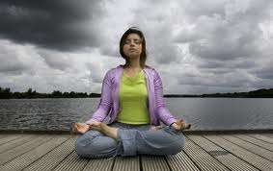
MEDITATION:

Slide 32
Meditation is a holistic discipline during which time the practitioner trains his or her mind in order to realize some benefit. Meditation is generally a subjective, personal experience and most often done without any external involvement, except perhaps prayer beads to count prayers.

Slide 33
Meditation often involves invoking and cultivating a feeling or internal state, such as compassion, or attending to some focal point, etc. The term can refer to the process of reaching this state, as well as to the state itself.

Slide 34

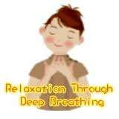

Slide 35
Diaphragmatic
breathing,
abdominal
breathing, belly breathing, deep breathing or costal breathing is the act of breathing deep into one's lungs by flexing one's diaphragm rather than breathing shallowly by flexing one's rib cage. This deep breathing is marked by expansion of the abdomen rather than the chest when breathing.

Slide 36
NOOTROPICS
Nootropics also referred to as smart drugs, memory enhancers, and cognitive enhancers, are drugs, supplements, nutraceuticals, and functional foods that improve mental functions such as cognition, memory, intelligence, motivation, attention, and concentration.

Slide 37
Nootropics are
thought to availability
work by of the
altering brain's
the supply
of neurochemicals
(neurotransmitters,
enzymes, and
hormones), by improving the brain's oxygen supply, or by stimulating nerve growth. However the efficacy of nootropic substances, in most cases, has not been conclusively determined.

Slide 38
RELAXATION TECHNIQUES:
Relaxation technique (also known as relaxation training) is any method, process, procedure, or activity that helps a person to relax; to attain a state of increased calmness; or otherwise reduce levels of anxiety, stress or anger.

Slide 39
Relaxation techniques are often employed as one element of a wider stress management program and can decrease muscle tension, lower the blood pressure and slow heart and breath rates, among other health benefits.

Slide 40
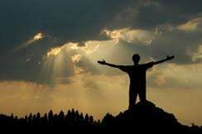
FRACTIONAL RELAXATION:

Slide 41
Fractional relaxation is a method of releasing muscular tension in one small part of the body at a time.

Slide 42
The fractional relaxation approach is often used in preparation for trance induction and hypnosis, but is very useful as a relaxation technique by itself. The theory behind this tension release method is that it is easier to relax a fraction of the body than it is to relax the whole body all at once.

Slide 43
Always take time for yourself at least 30 min/ day.
Be aware of your own stress meter; know when to step back and cool down.
Concentrate on controlling your own situation, without controlling everybody else.

Slide 44
Daily exercise will burn off the stress chemicals.
Eat lots of fresh fruit, veggies, bread and water; give your body the best for it to perform at its best.
Forgive others, do not hold grudges and be tolerant; not everyone is capable as you.
Gain perspective on things, how important is the issue?
Hugs, kisses and laughter; have fun and don‘t be afraid to share your feelings with others.

Slide 45
Identify stressors and plan to deal with them better next time.
Judge your own performance realistically; don‘t set goals out of your own reach.
Keep a positive attitude, your outlook will influence outcomes and the way others treat you.
Limit alcohol, drugs and other stimulants, they affect your perception and behavior.
Manage money well, seek advice and save at least 10% of what you earn.

Slide 46
No is a word you need to learn to use without feeling guilty.
Outdoor activities by yourself, or with friends and families, can be a great way to relax.
Play your favorite music rather than watching TV.
Quit smoking; it is stressing your body daily, not to mention killing you too.
Relationships; nurture and enjoy them, learn to listen more and talk less.

Slide 47
Sleep well, with firm mattress and supportive pillow; don‘t over heat yourself and allow plenty of ventilation.
Treat yourself once a week with a massage, dinner out and the movies.
Understand things from the other person point of view.
Verify information from the source before exploding.

Slide 48
Worry less, it really doesn‘t get things completed better or quicker.
Yearly goal setting; plan what you want to achieve based on your priorities in your career, relationships etc
Zest for life; each day is a gift, smile and be thankful that you‘re the part of the bigger picture.

Slide 49


